Slide 1

Brownian Dynamics Simulation
End-Term Report
Pradhyumna Lavania
200692

Slide 2
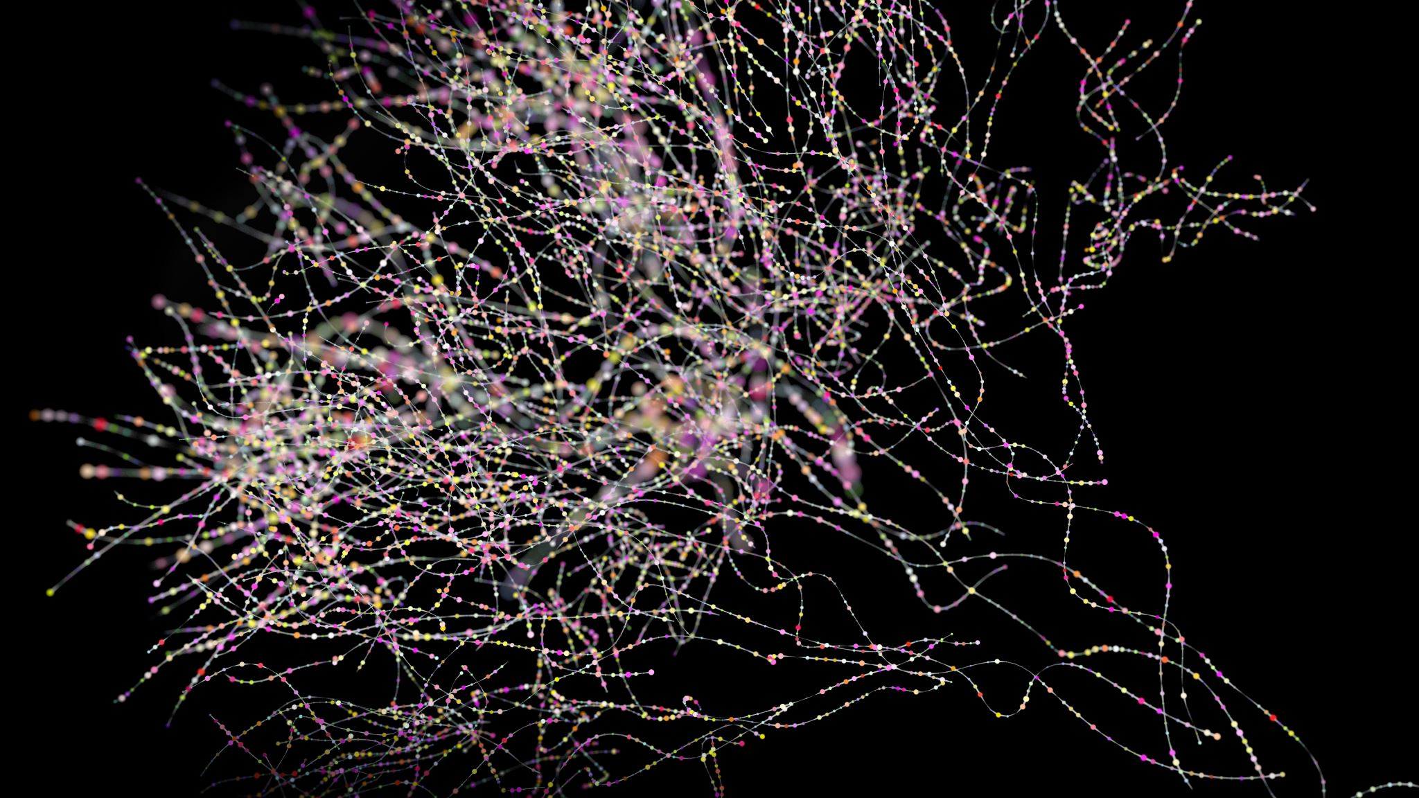
Overview of the Project
The random motion of the particles suspended in liquid and gas phase is called Brownian Motion.
The driving factor for the motion is the collisions between the particles.
The Collisions happen because of inertial , drag and buoyancy forces experienced by the particle in the liquid/gas medium.
The project aimed to study and simulate the Brownian Motion of the particles.

Slide 3
Assignment 1
The Assignment 1 aimed to familiarize the Equations of motion under the influence of drag force, buoyancy force and Weight of the particle.
Task of calculating the velocity under the influence of above-mentioned forces was given.
Both Analytical and Numerical Analysis were done.

Slide 4
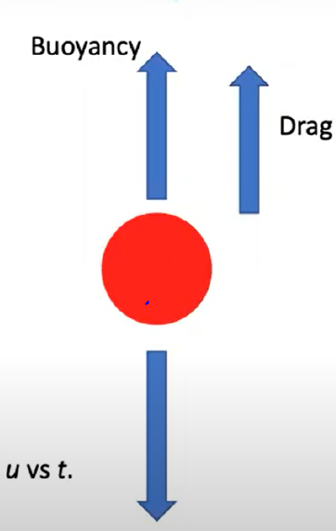
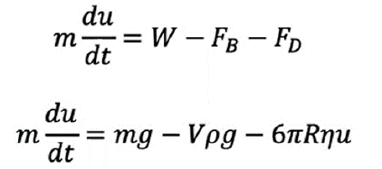
Equation of Motion

Slide 5

Analytical Solution
The analytical solution was worked out on pen and paper with final solution expression coming out to be:

Slide 6
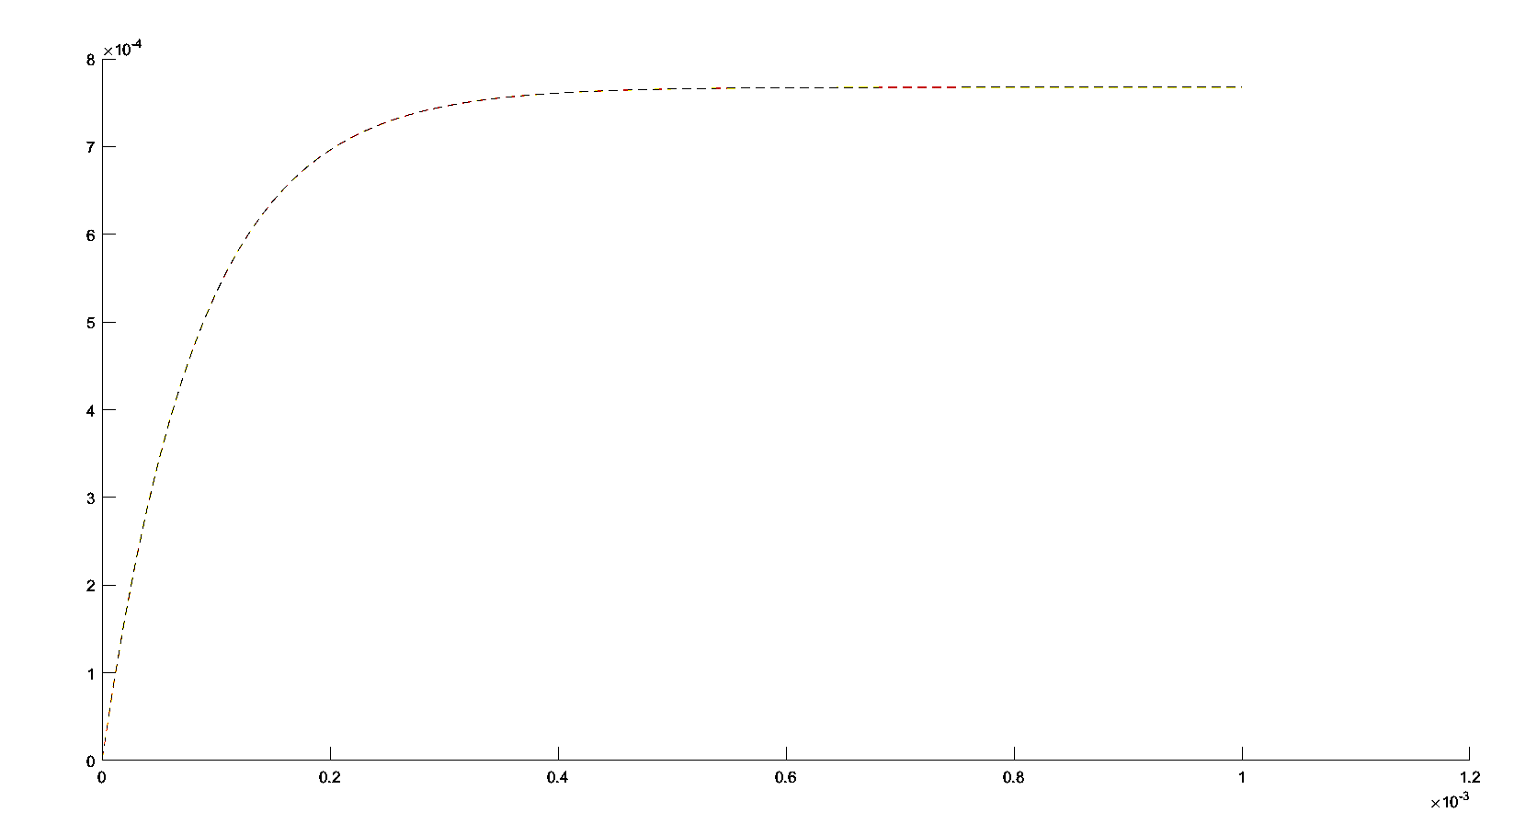
Analytical Expression Graph

Slide 7
Numerical Analysis
The numerical analysis was done to approximate the solution of differential equation by Euler’s Method.
In Euler’s Method the velocity is discretely calculated taking gradient constant for small time interval then simply calculating the velocity.
More the number of iterations more the graph will be similar to exact solution graph.
In the question 10^5 iterations were performed for 100 seconds interval.

Slide 8
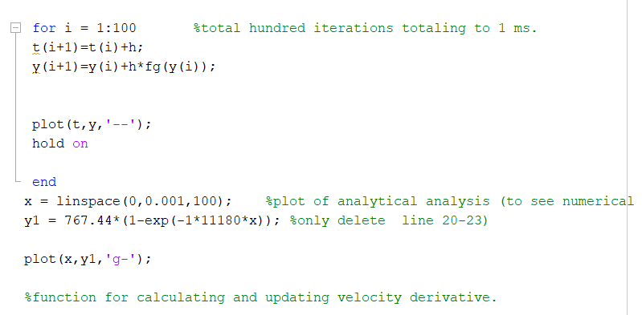
Code Snippet

Slide 9
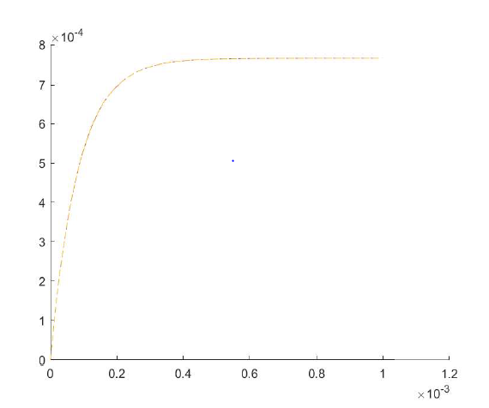
Graph

Slide 10
Observations and Results
The graph of Exact solution as well as Numerical Analysis plot came out to be nearly similar due to the extremely high number of iterations due to which less deviation happened.
The terminal velocity was reached in nearly 0.4 ms according to the data given in the assignment.

Slide 11
Assignment 2
Basics of Brownian Dynamics were discussed in this course.
We simulated the motion of the particle under the influence of Brownian Force.
Mean standard deviation and Diffusivity was calculated

Slide 12

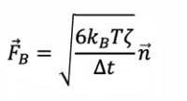
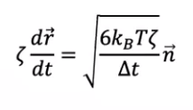
Equation Of Motion
The equations were formulated considering inertia to be nearly 0.

Slide 13
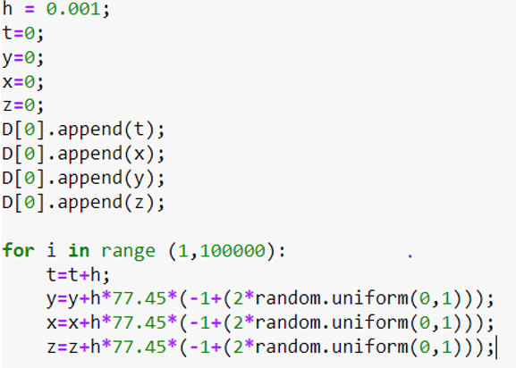
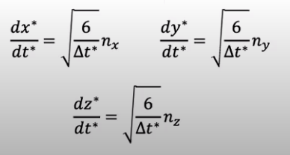
Code used to generate x , y, z coordinate
For del t*=0.001
root(6/0.001)= 77.45

Slide 14
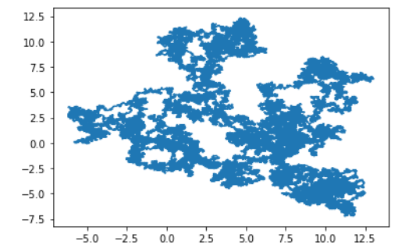
Trajectory Generated (100000 iterations)
This is the trajectory generated using 2 coordinates x and y.

Slide 15
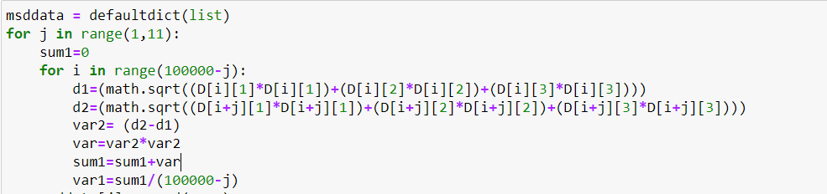
Mean Standard Deviation
The Mean Standard Deviation is measure to calculate the degree of deviation in a certain quantity over a certain time interval.
The Code snippet which was used to calculate the MSD is attached:

Slide 16
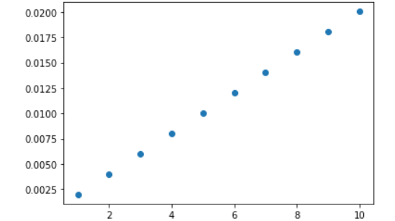
Graph of MSD over different time intervals:

Slide 17
Assignment 3
Basics of Molecular Chain Dynamics were discussed.
We studied the alterations in chain length under the influence of Brownian Force.
RMS value of chain with iteration was calculated

Slide 18
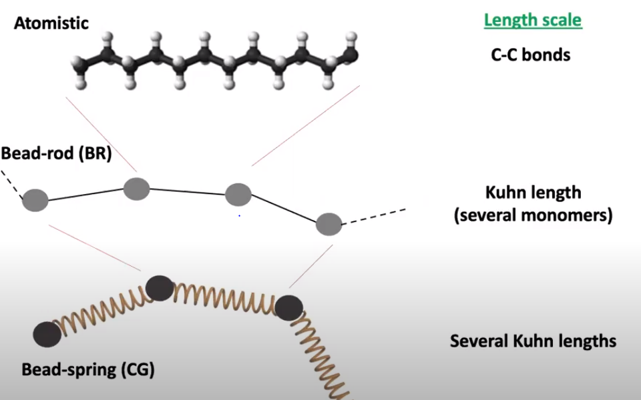
Theory
For simulating the polymer chain model we approximated the several monomers in Bead chain model. Where several monomer length is equal to Kuhn Length.
Several Kuhn length make up to Bead Spring model where, we assume there is spring acting between two springs.

Slide 19
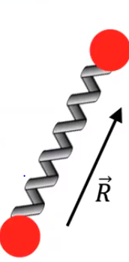


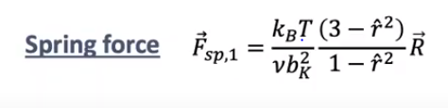
Dynamics of Single Polymer Chain

Slide 20
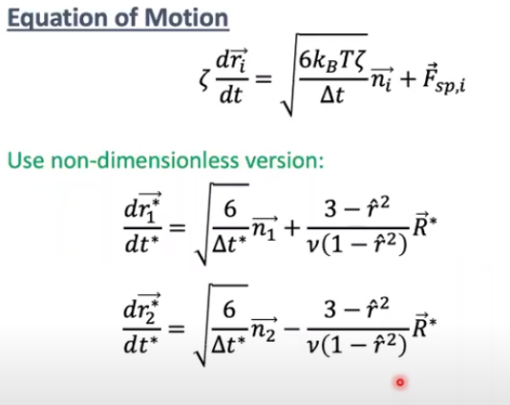
Continued:
The equation of motion :
The Equation of Motion is calculated by applying all three forces.
Dimensionless equation was used to ease the calculations.

Slide 21
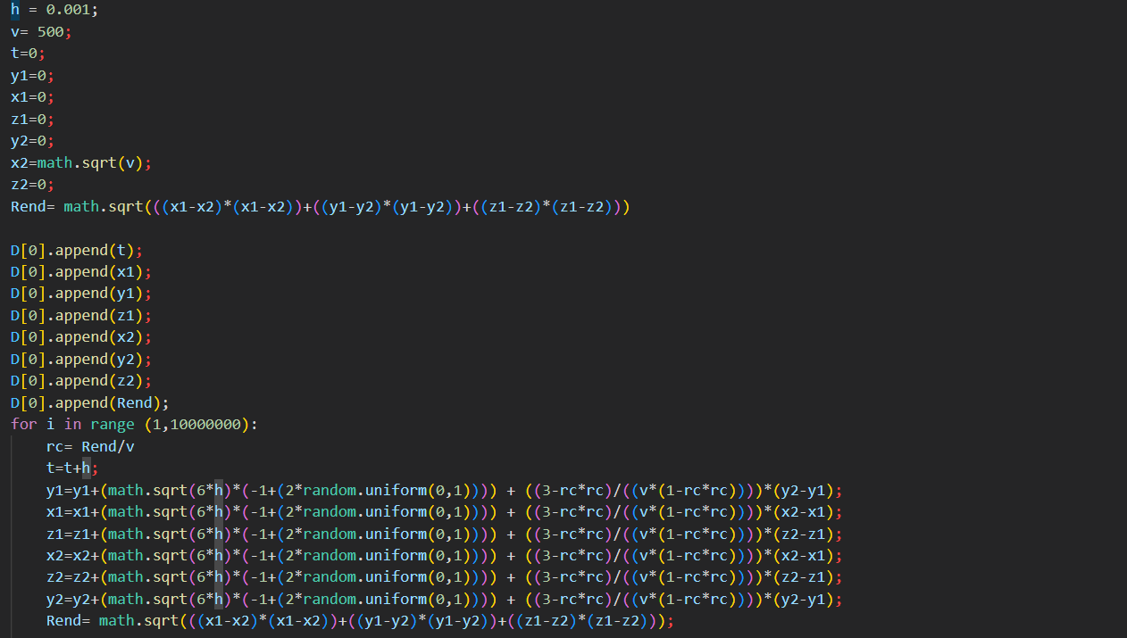
Code Snippet:

Slide 22
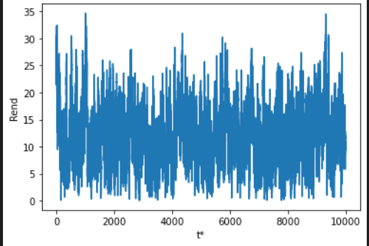
Graph of Rend Vs t* (10^7-Iterations)

Slide 23
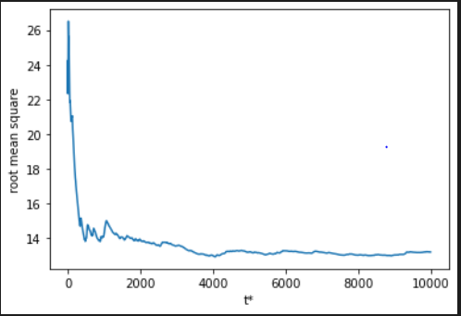
Graph of RMS Value With t*

Slide 24
Thank You !

